Slide 1
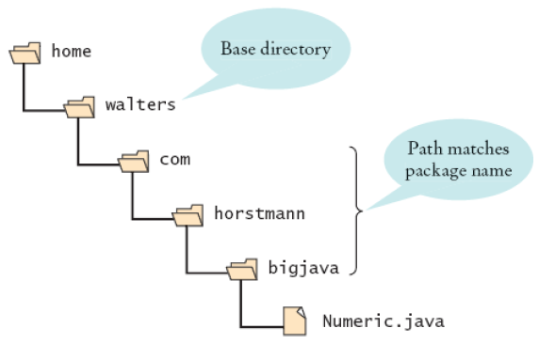
Base Directories and Subdirectories for Packages
Figure 6:
Base Directories and Subdirectories for Packages

Slide 2
Shapes
For each class in your shapes package…
  Line, Rectangle, Circle, Sphere
…you must have JavaDoc comments for all public features…
  The class itself
  Methods
…that utilize appropriate tags.
  For the class: author, version
  For methods: param, return, pre, post

Slide 3
Try This
First, you must ensure that the JDK is part of your system path.
Then, go to your project directory (not inside the package directory).
Now run the javadoc command, but at the very end, use the name of the package you want to javadoc.
echo $PATH
cd /cygdrive/e/PATH TO PROJECT
javadoc -author -version -tag pre:cm:"Precondition:" -tag post:cm:"Postcondition:" -d doc -classpath ./lib/* -sourcepath ./src/ shapes

Slide 4
Try That
First, you must ensure that the JDK is part of your system path.
Then, go to your project bin directory (not inside the package directory).
Now run the jar command, but at the very end, use the name of the package you want to jar.
echo $PATH
cd /cygdrive/e/PATH TO PROJECT/bin
jar cvf shapes.jar shapes

Slide 5
Turning in the Shapes Library
YOUR_NAME.zip
/Shapes
    /src
    /drawings
    Tester.java, DrawingSurface.java
      /shapes
      Line.java, Rectangle.java, Circle.java, Sphere.java
    /lib
      core.jar
    /doc
      [all javadoc generated html and subdirectories]
    /dist
      shapes.jar

